Slide 1
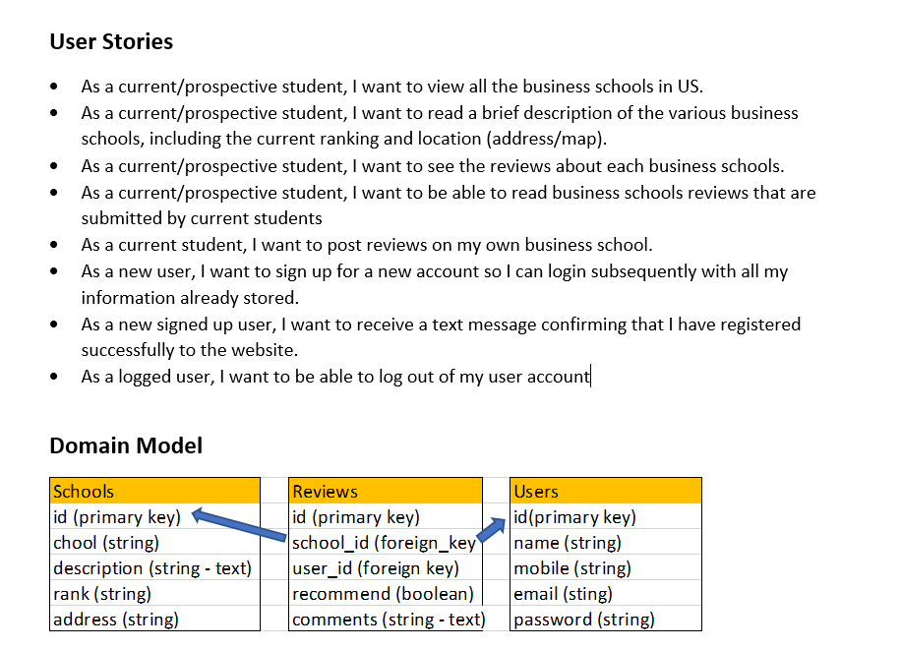

Slide 2
MBA Reviews
Home
Sign Up
Sign In
2021 Best Business Schools
A career in business starts with finding the MBA program that fits your needs. With the U.S. News rankings of the top business schools, narrow your search by location, tuition, school size and test scores
ABC Business School
XYZ Business School
123 Business School
Notes:
HOME PAGE

Slide 3

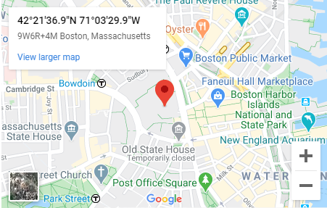


MBA Reviews
Home
Sign Up
Sign In
Logged in as ABC
Logout
Rank
#10
Address
ABC Dempster Road, IL 20202
ABC Business School
ABC is the graduate business school of ABC University. Located in Boston, Massachusetts, it is consistently ranked among the top business schools in the world and offers a large full-time MBA program, management-related doctoral programs, and many executive education programs.
Reviews by student
Number of reviews
###
Write a review
Notes:
PAGE FOR EACH ATTRACTION

Slide 4
MBA Reviews
Home
Sign Up
Sign In
Logged in as ABC
Logout
Review for ABC Business School
Would you recommend the school to others?
[“Insert drop down option”]
Yes/No
Comments
Submit
Notes:
USER REVIEW SUBMISSION PAGE

Slide 5
MBA Reviews
Home
Sign Up
Sign In
Sign Up
Your name
Your mobile number
Email address
name@example.com
Password
Sign Up
Notes:
SIGN UP PAGE

Slide 6
MBA Reviews
Home
Sign Up
Sign In
Thanks for signing up! A message has been sent to your mobile number to confirm your registration.
Go home
Notes:
SIGN UP SUCCESSFUL PAGE

Slide 7
MBA Reviews
Home
Sign Up
Sign In
Login
Email address
name@example.com
Password
Sign In
Notes:
SIGN IN PAGE

Slide 8
MBA Reviews
Home
Sign Up
Sign In
Thanks for signing in.
Go home
Notes:
SIGN IN SUCCESSFUL PAGE

Slide 9
MBA Reviews
Home
Sign Up
Sign In
Login failed. Please re-enter your email and/or password.
Go home
Notes:
SIGN IN FAILED PAGE

Slide 10
MBA Reviews
Home
Sign Up
Sign In
You have been signed out
Go home
Notes:
LOGOUT PAGE

